Slide 1


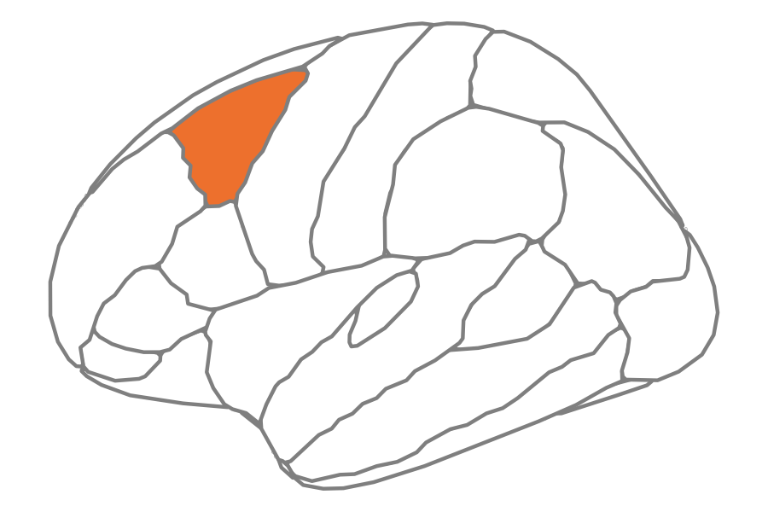
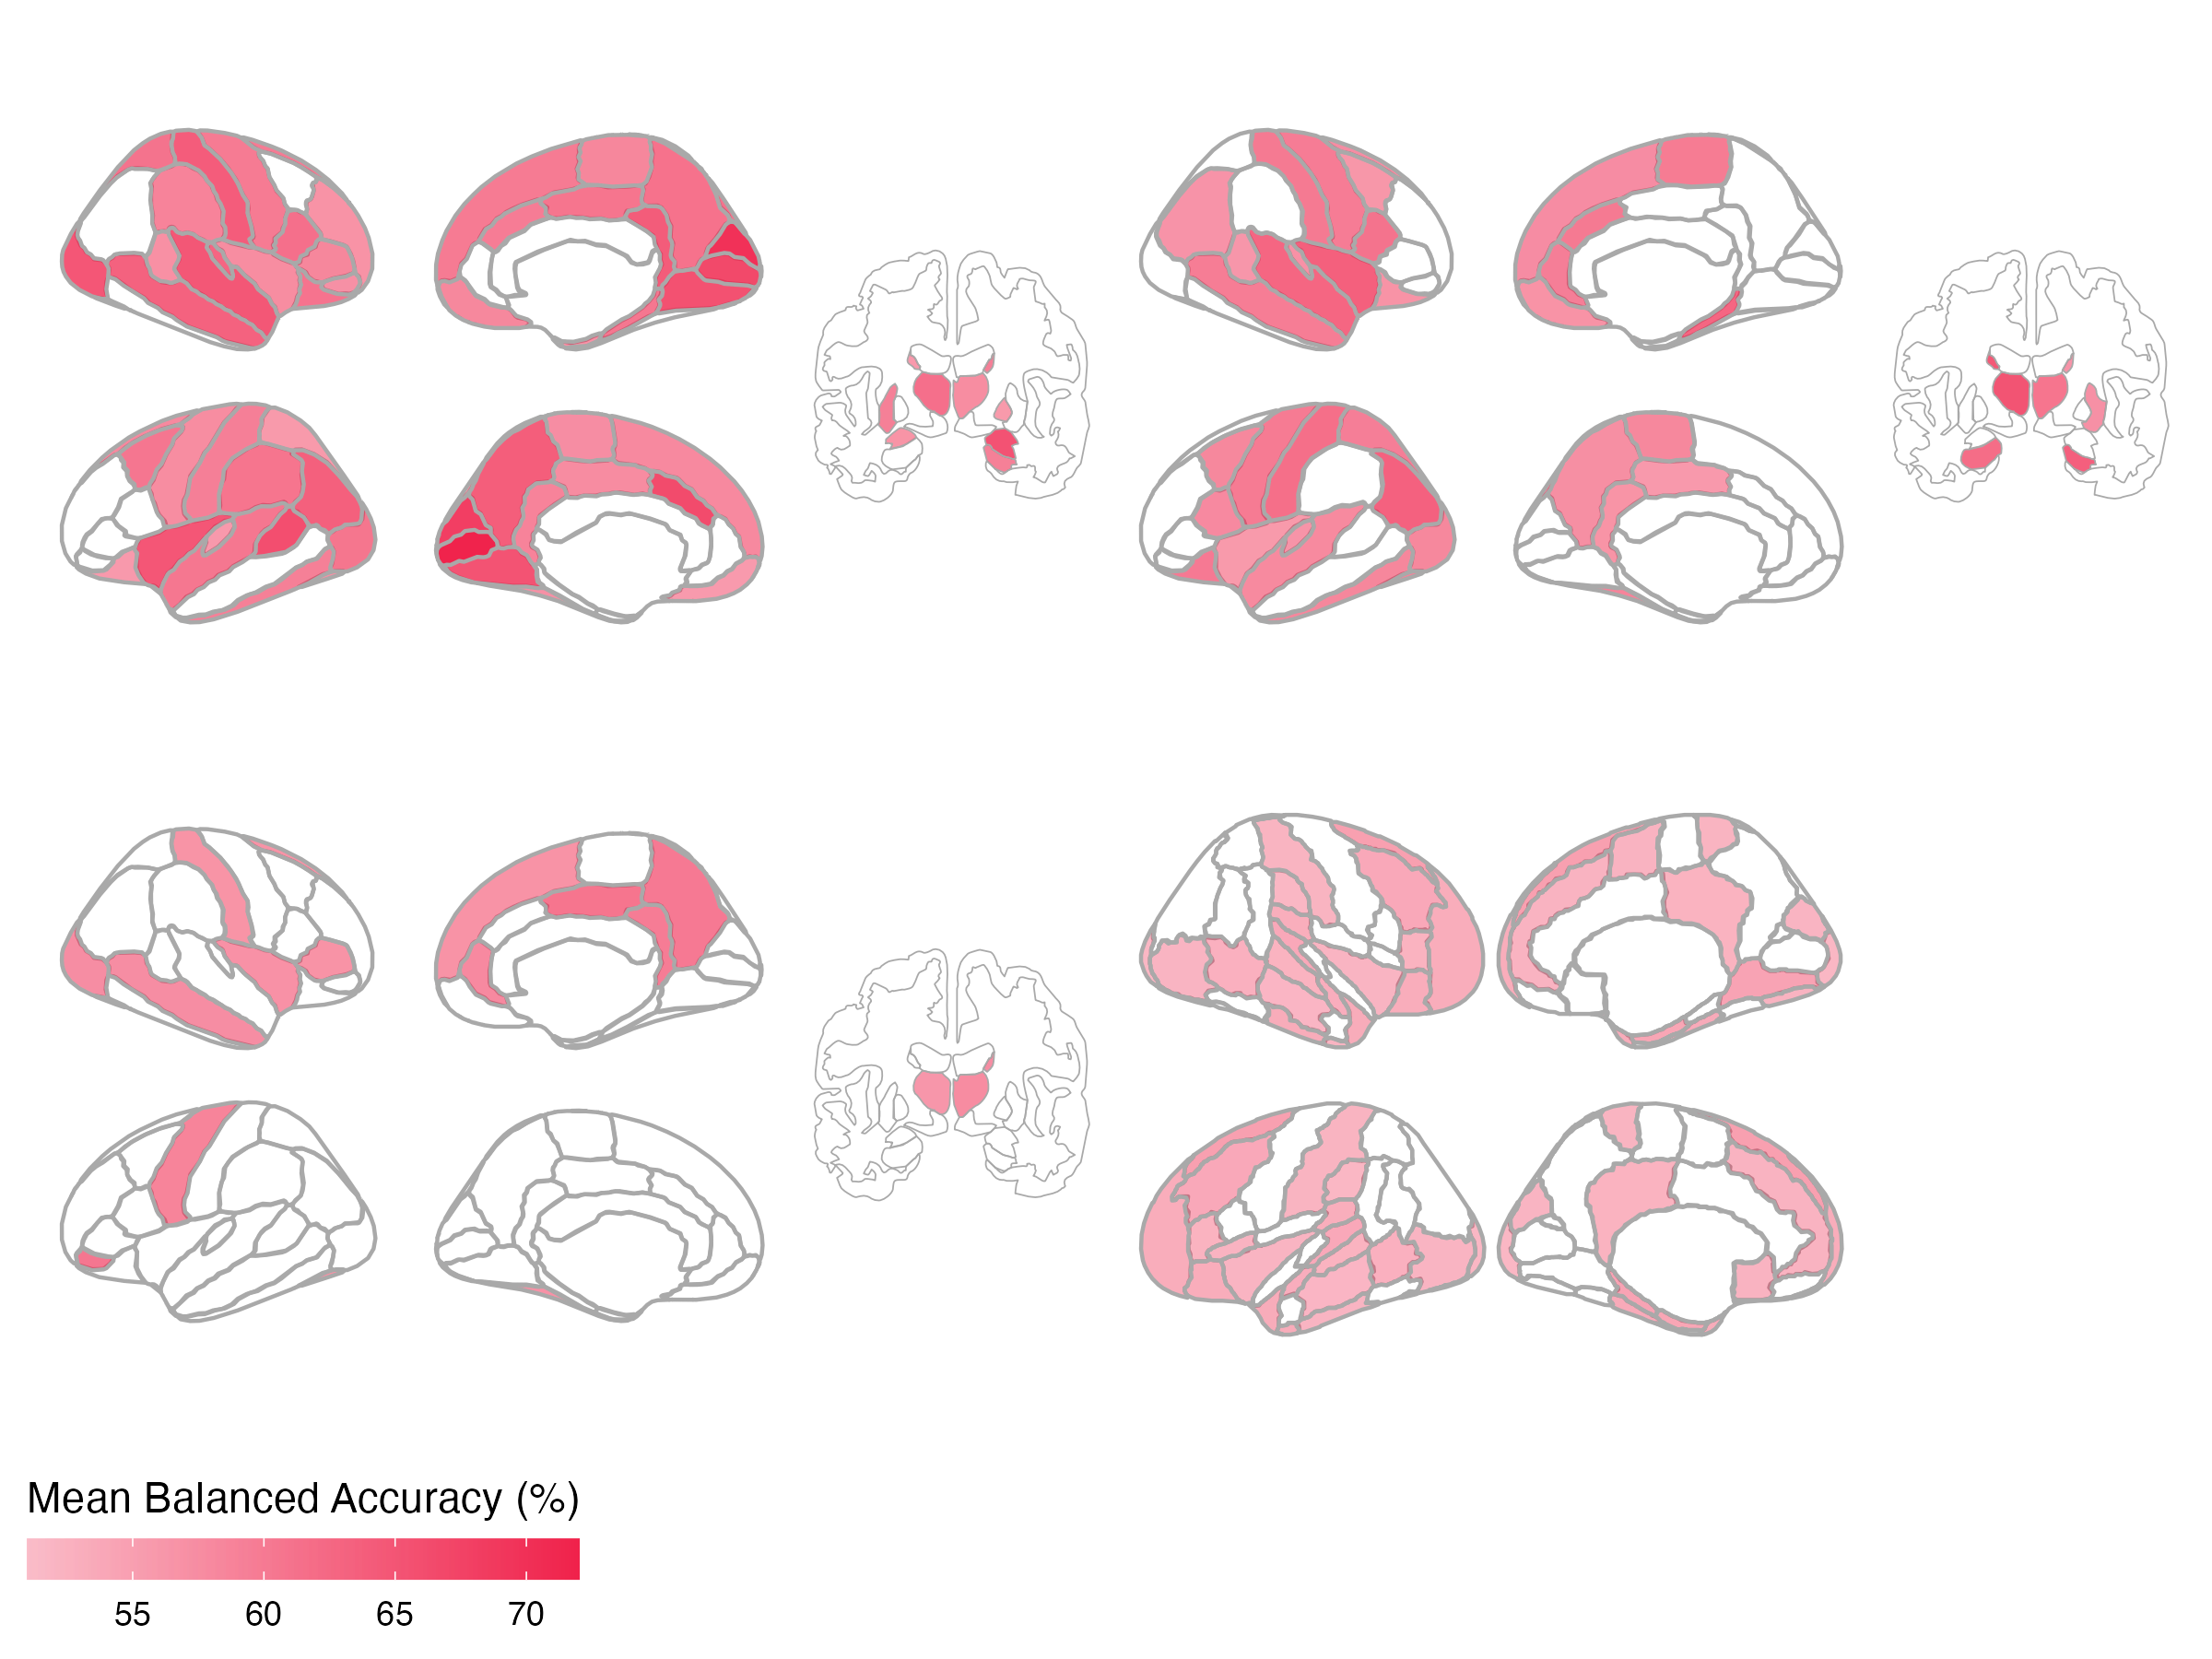
A
Features
Region 1
Region 1
Repeat for all N brain regions
Linear SVM
B
SCZ
BPD
R
63 regions
44 regions
L
ADHD
ASD
17 regions
27 regions
Notes:
Figure 2. Univariate time-series feature classification results.

Slide 2
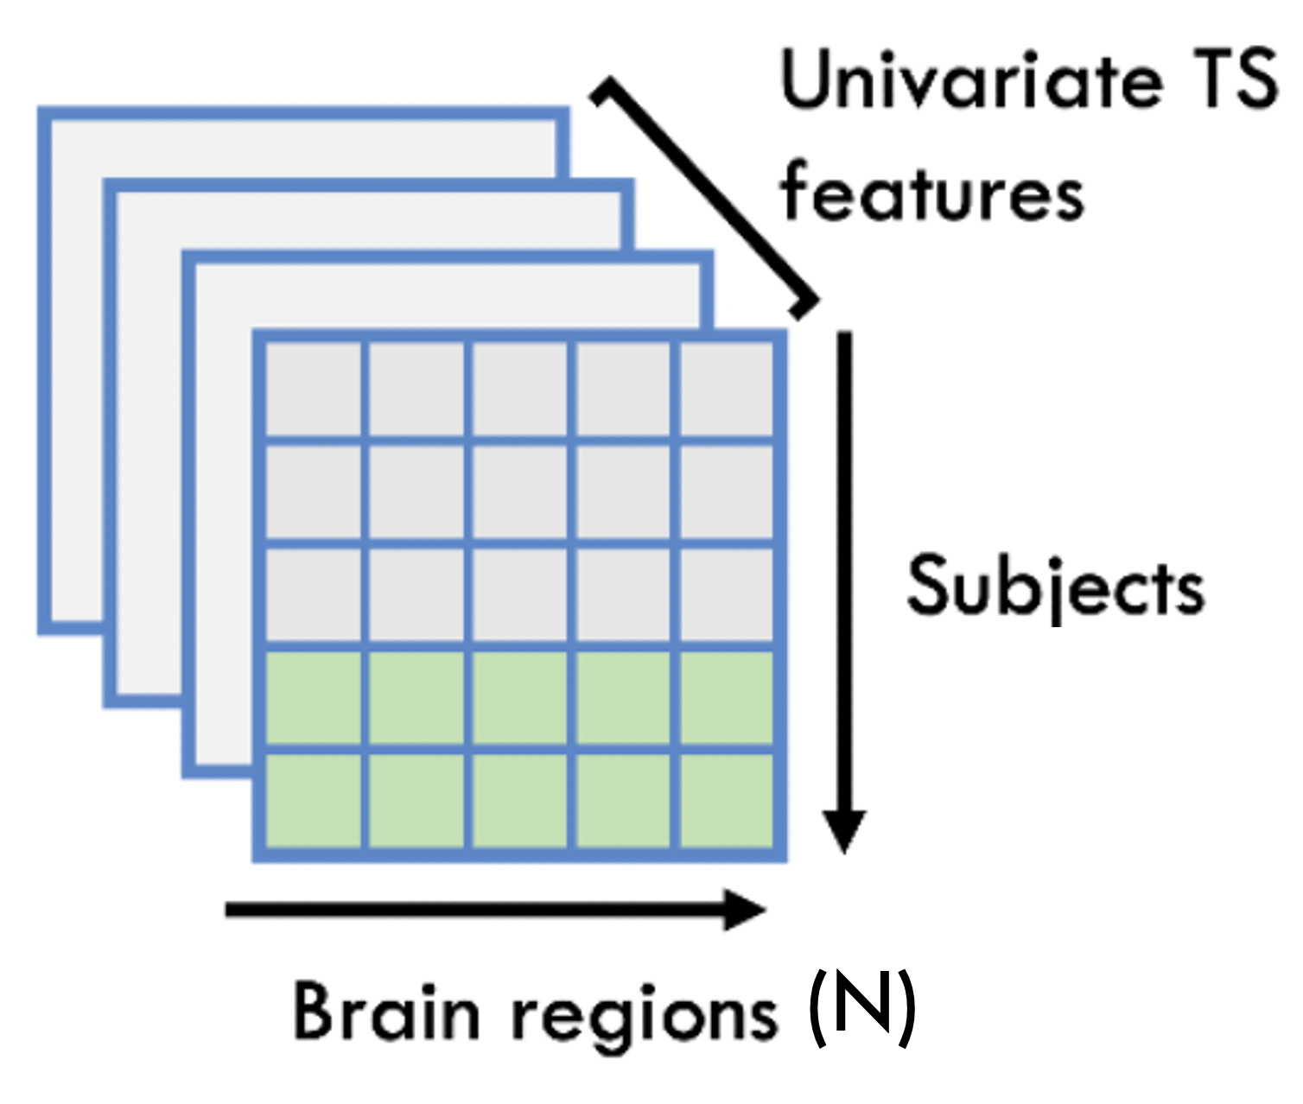
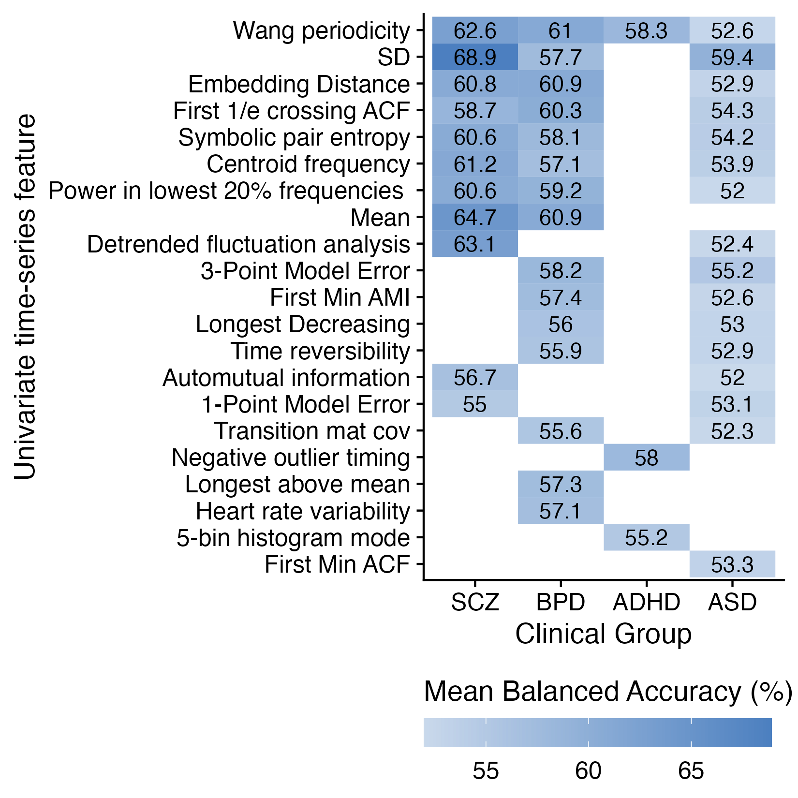
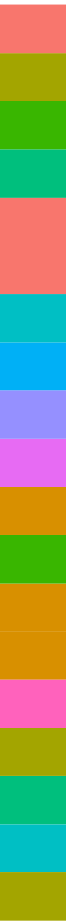
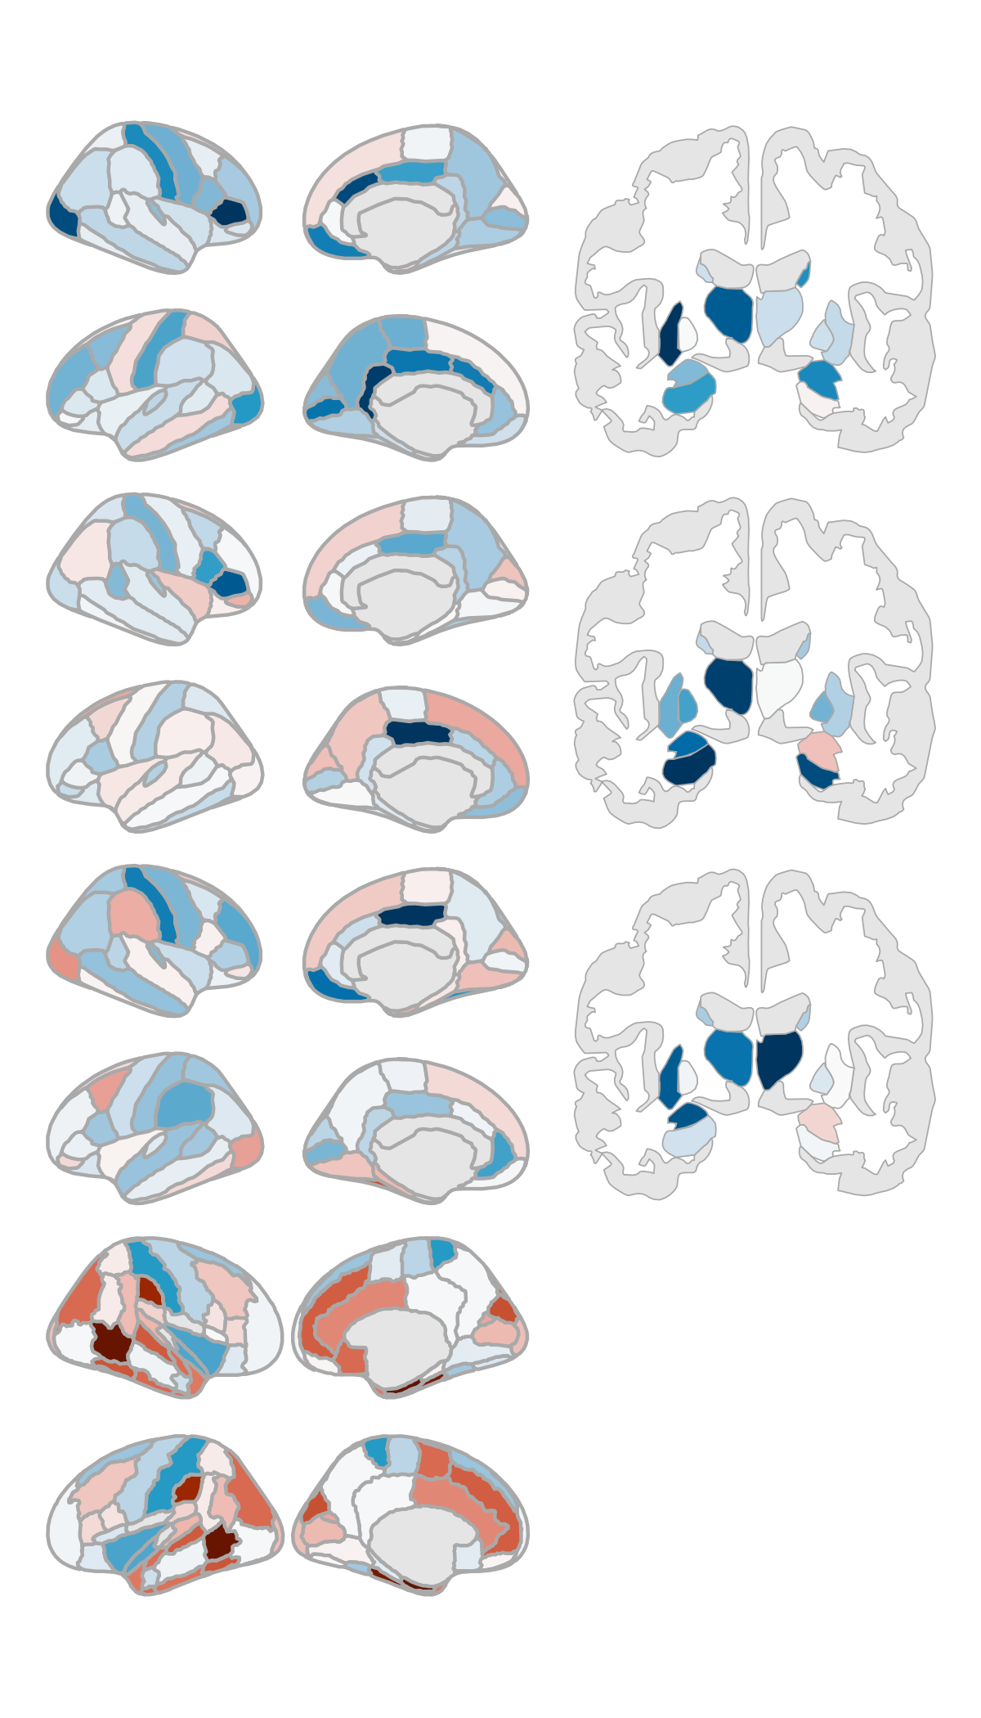
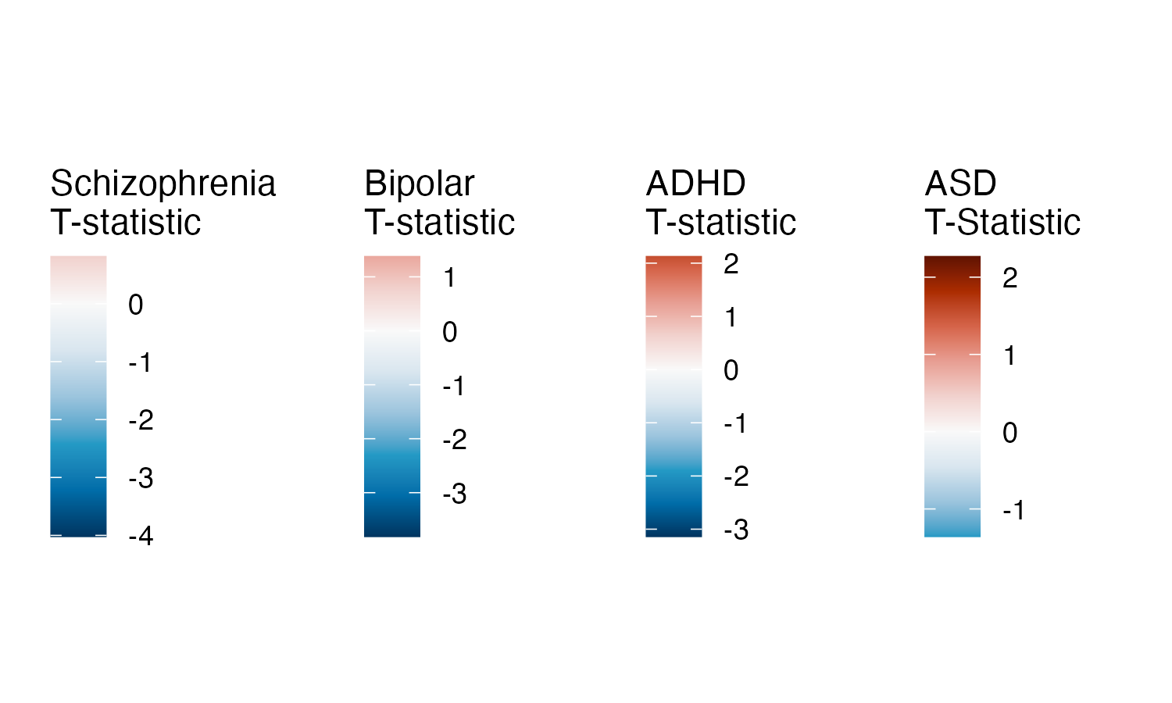
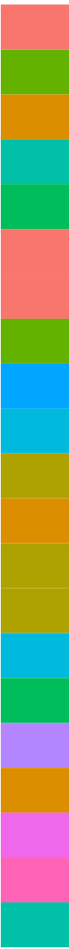
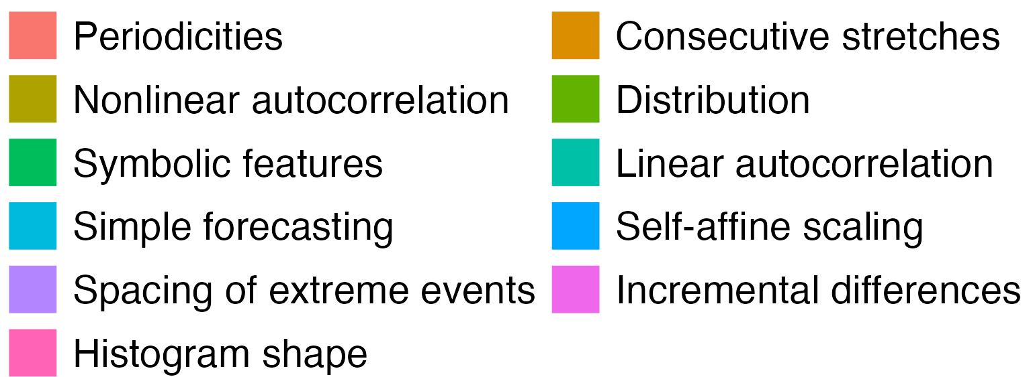
A
Features
Feature 1
Feature 1
Repeat for all 24 TS features
Linear SVM
B
C
Notes:
Figure 2. Univariate time-series feature classification results.

Slide 3
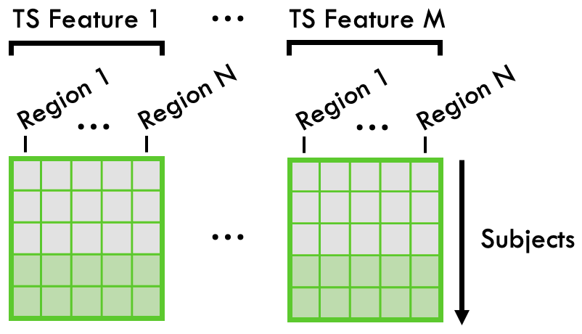
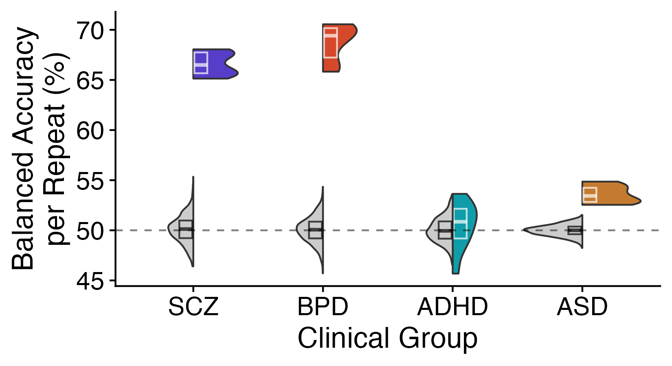
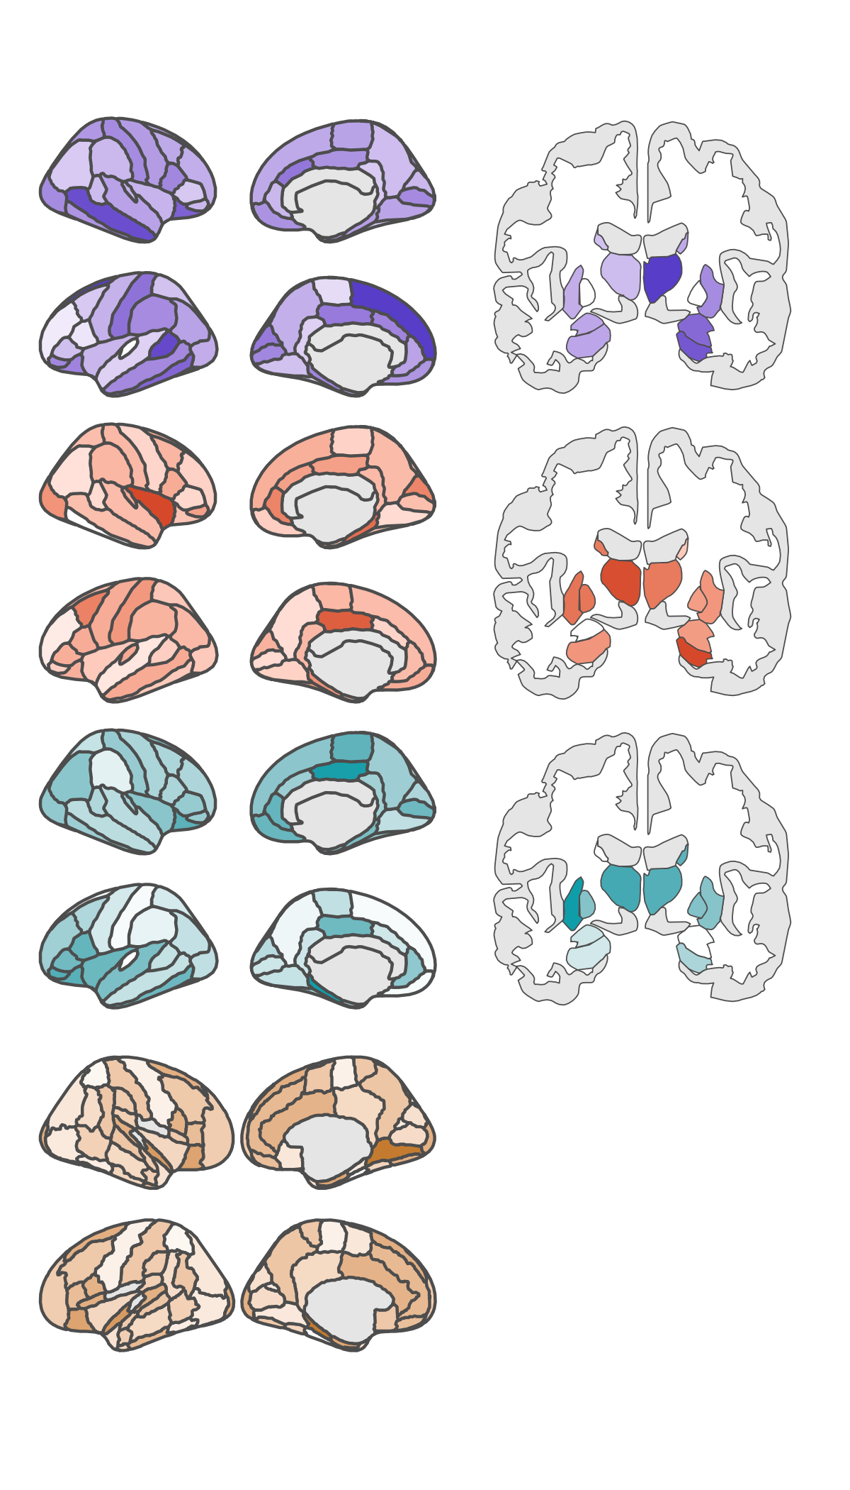
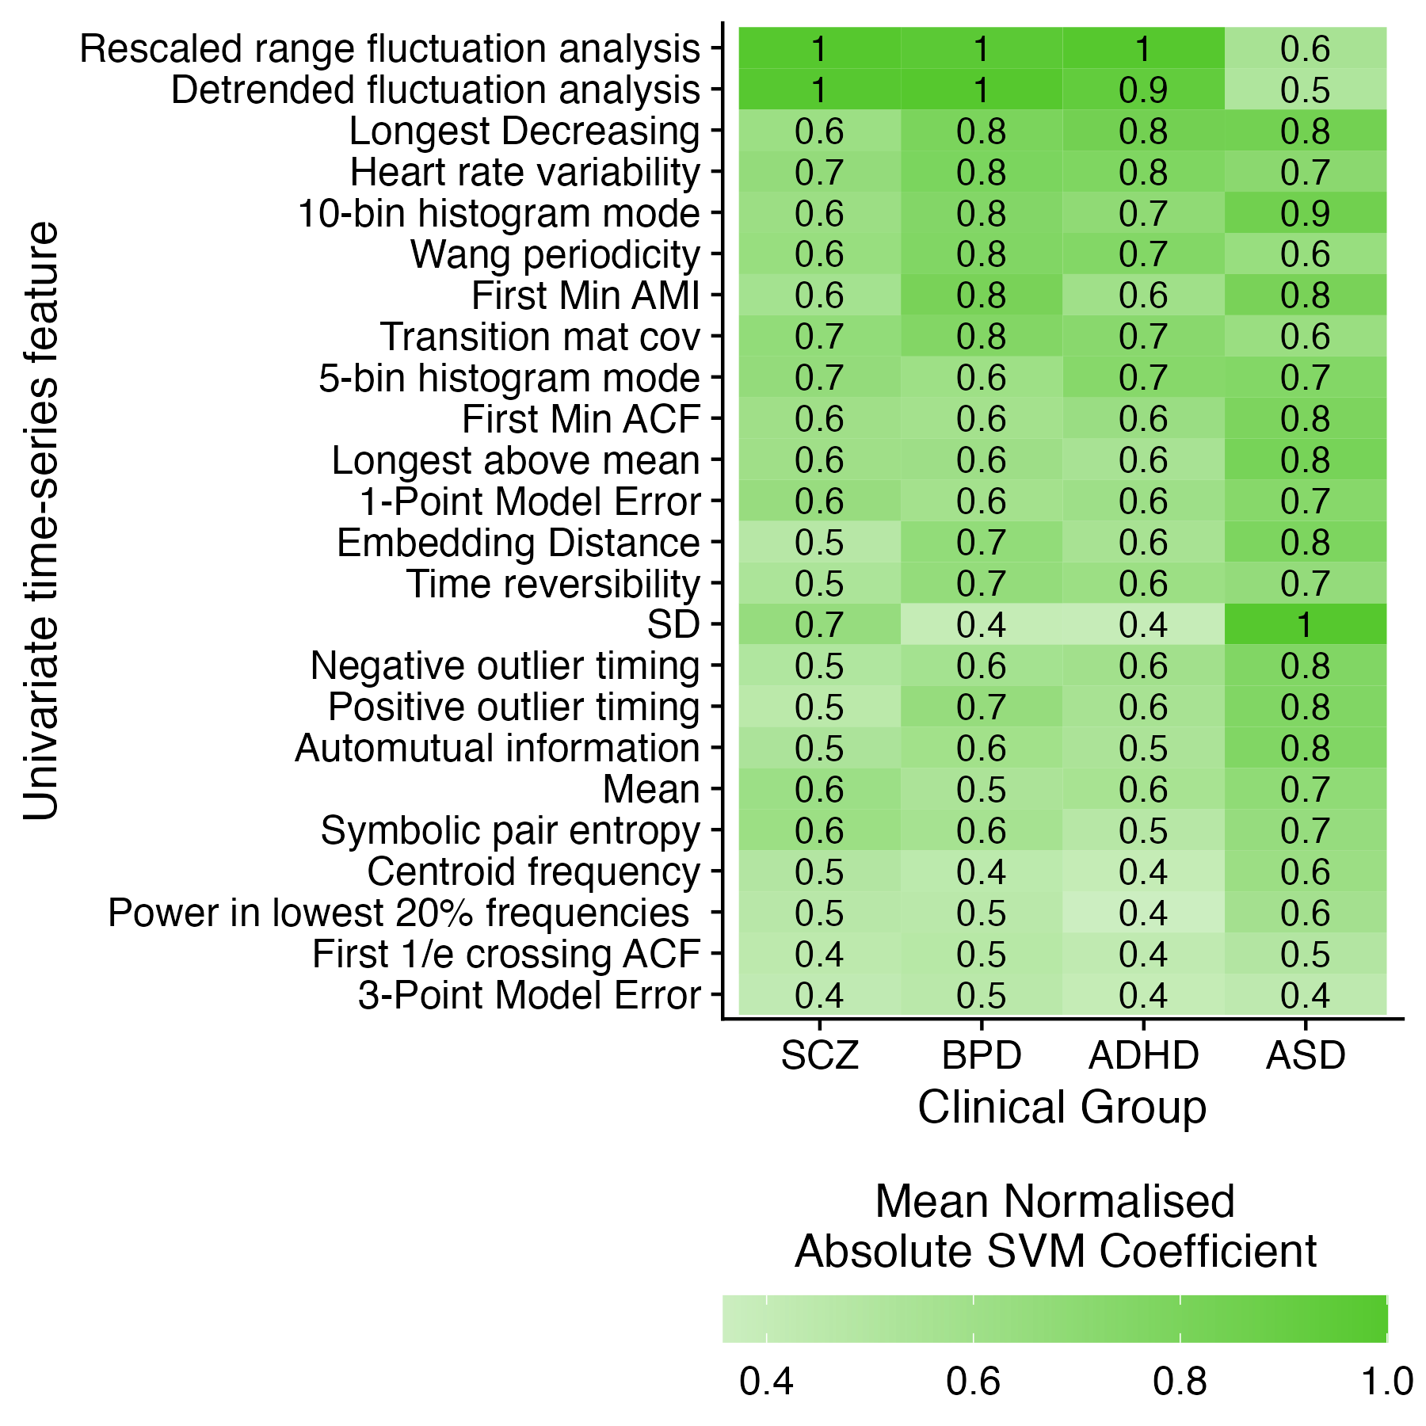
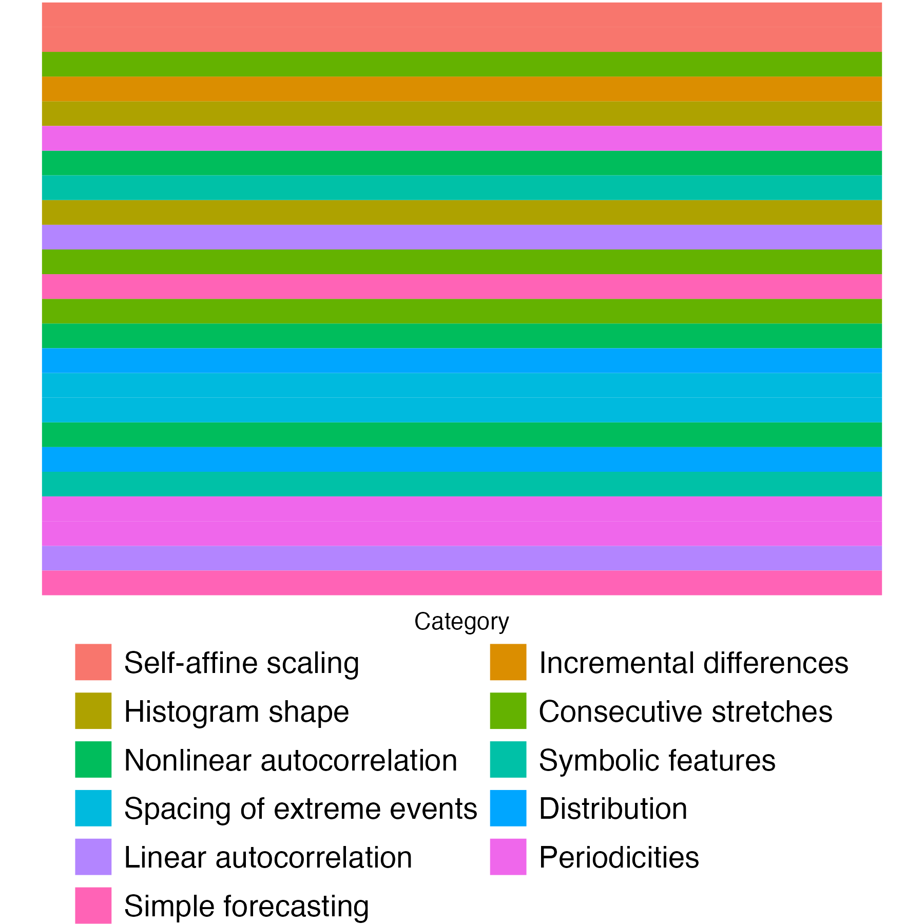
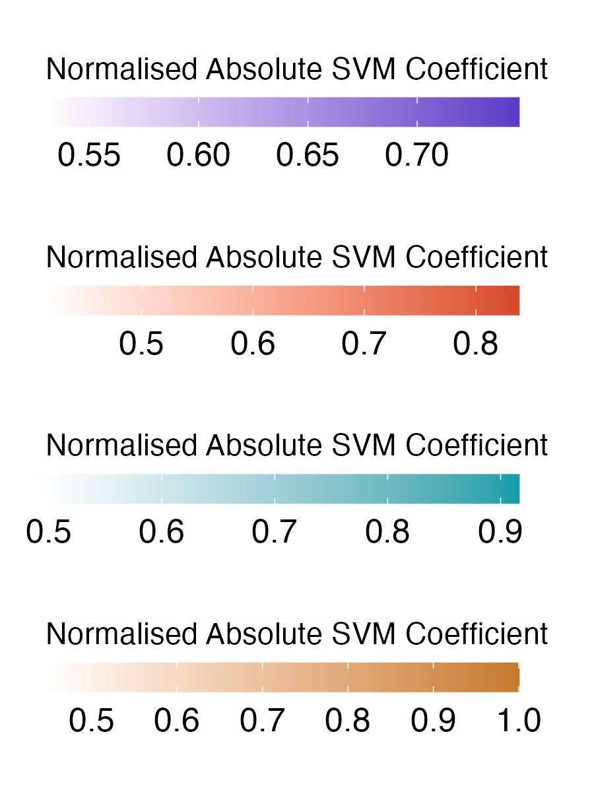
A
B
***
***
***
Features
Linear SVM
C
SCZ
BPD
D
ADHD
ASD
Notes:
Figure 2. Univariate time-series feature classification results.

Slide 4
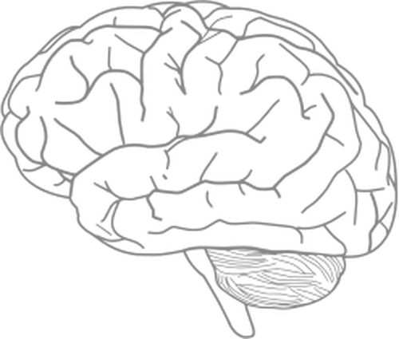
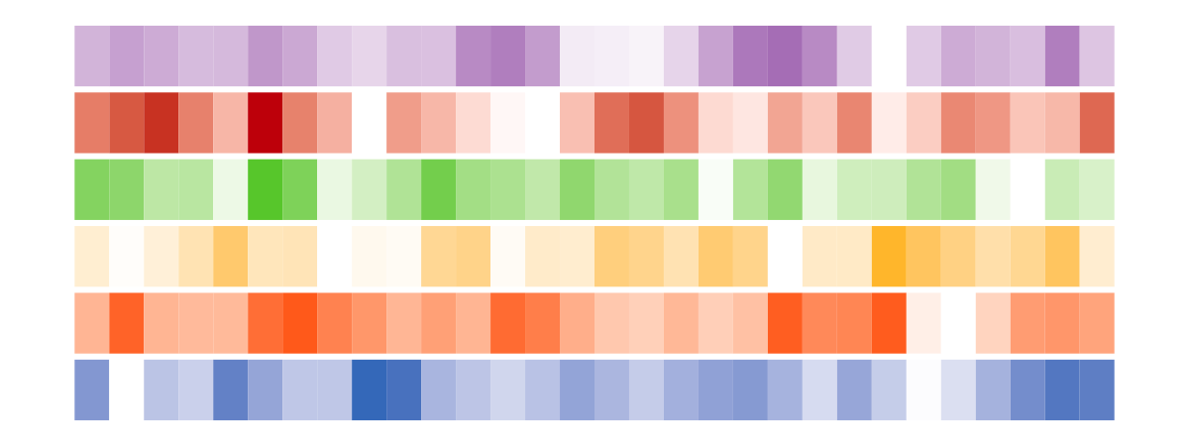
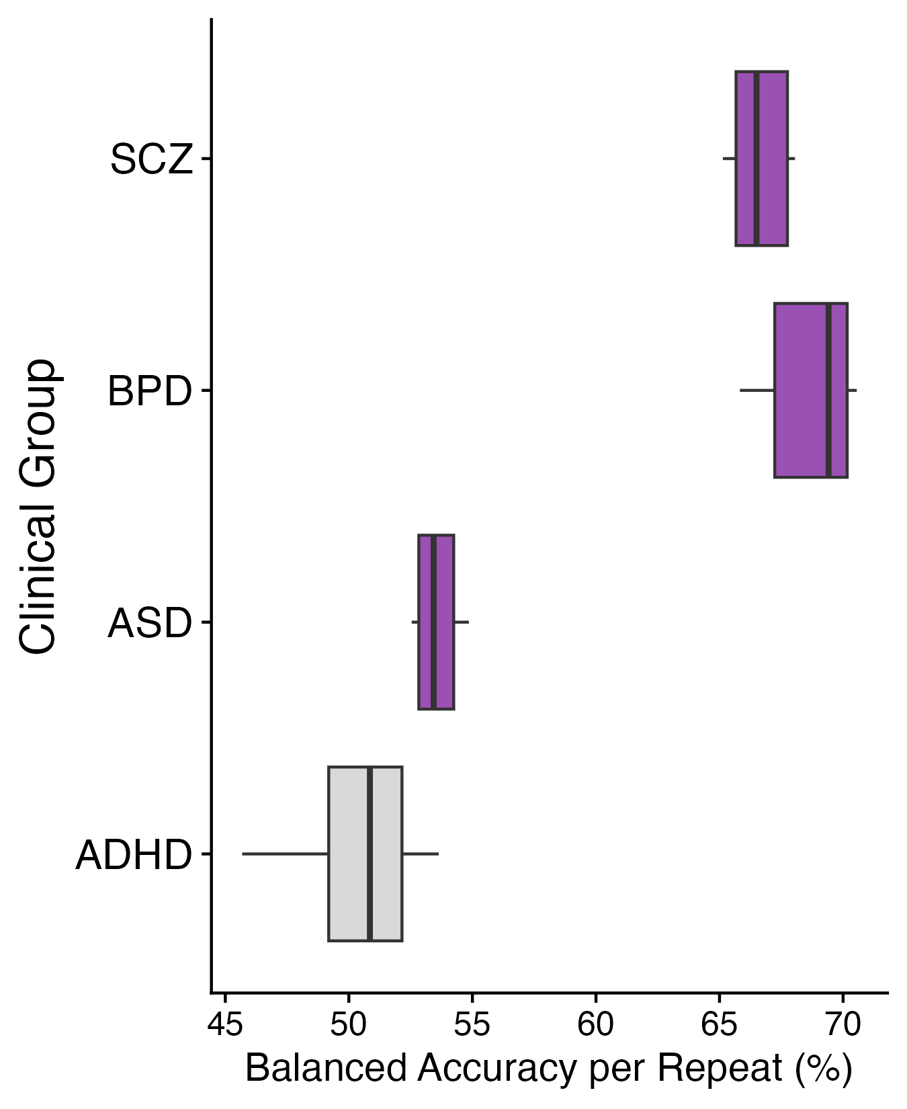

A
B
BPD
SCZ
R
43 regions
30 regions
L
ADHD
ASD
10 regions
19 regions
C
D
List feature with largest magnitude SVM coefficient per model
Show SVM coefficients for PD PeriodicityWang
Notes:
Figure 2. Univariate time-series feature classification results.

